Slide 1
Passive Realtime Datacenter Fault Detection and Localization
2017 14th USENIX Symposium on Networked Systems Design and Implementation
Arjun Roy, Hongyi Zeng , Jasmeet Bagga , and Alex C. Snoeren UC San Diego and Facebook, Inc

Slide 2
Background
Networks grow rapidly in scale
• Ten thousands of network devices
• Hundred thousands of links
• Failures become common
• Fail-stop failures
• Partial failures
Notes:
最近，来自微软的作者描述了[44]一个流氓的数据中心故障：灰尘弥漫的光纤连接器导致数据包损坏、交换机软件错误、硬件故障、错误的ECMP负载平衡、不可靠的计数器等等。
使问题复杂化的是，故障可能是间歇性的和局部的：链路或交换机可能只影响通信量的一个子集，从而使检测和诊断复杂化
例如，NetPilot[42]的作者描述了单个链路丢下一小部分数据包，再加上直通路由，如何导致应用程序性能下降，并需要数小时的网络搜索来识别故障设备。
1%的partial failure导致99%的应用程序的时延增加4.5倍
Partial failure can affect fix 5-tuple flow,or randomly drop packet

Slide 3
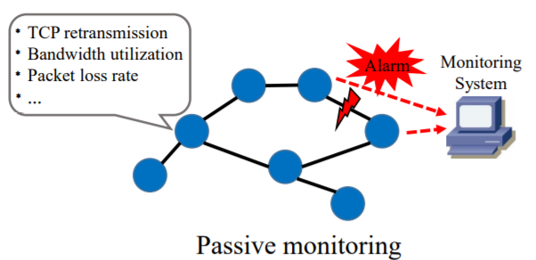
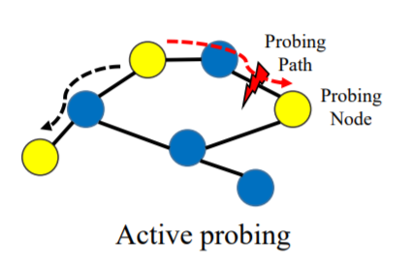
Background
Passive monitoring
• Use readily available metrics to generate failure alarms
• Additional hardware monitors
• Active probing
• Inject probing packets to monitor the network status
• Cannot distinguish fail-stop and partial failures
• Incur high cost
• Many probing packets and forwarding rules
• Long probing time

Slide 4
Background
Passive monitoring
• Use readily available metrics to generate failure alarms
• The downside is alarm signals are often missed
• Introduce many false alarms
• Turn failure localization into a long-time lagging process
• Active probing
• Inject probing packets to monitor the network status
• But it cannot provide accurate failure position
• Due to the unknown routing in traditional networks

Slide 5
Background
Monitoring approaches
End-host monitoring (RPC latency, TCP retransmits, etc.)
Host monitoring alone lacks specificity in the presence of large scale multipath.
An application suffering from dropped packets or increased latency does not give any intuition on where the fault is located, or whether a given set of performance anomalies are due to the same fault.
Switch-based monitoring (drop counters, queue occupancies, etc.)
Similarly, if a switch drops a packet, the operator is unlikely to know which application’s traffic was impacted, or, more importantly, what is to blame. Even if a switch samples dropped packets the operator might not have a clear idea of what traffic was impacted.
Switch-counter based approaches are further confounded by cut-through forwarding and unreliable hardware
Notes:
RPC latency: Remote Procedure Calls
Host-end 在有多条路径的时候，不知道是哪条路径出故障/或者统计应用的RFC时延只是知道该应用出了问题也不知道丢包具体位置。
Switch的cpu比较低，所以收集到部分flow，很久才能收集到所有flow，只是收到包数目，也不知道哪些流量被影响。而且cut-through本来就会丢包
本篇文章提出的是End-host monitoring，而且可以识别出具体发生故障的link
1、直通交换方式（Cut-through）
采用直通交换方式的以太网交换机可以理解为在各端口间是纵横交叉的线路矩阵电话交换机。它在输入端口检测到一个数据包时，检查该包的包头，获取包的目的地址，启动内部的动态查找表转换成相应的输出端口，在输入与输出交叉处接通，把数据包直通到相应的端口，实现交换功能。由于它只检查数据包的包头（通常只检查14个字节），不需要存储，所以切入方式具有延迟小，交换速度快的优点。
它的缺点主要有三个方面：一是因为数据包内容并没有被以太网交换机保存下来，所以无法检查所传送的数据包是否有误，不能提供错误检测能力；第二，由于没有缓存，不能将具有不同速率的输入／输出端口直接接通，而且容易丢包。如果要连到高速网络上，如提供快速以太网（100BASE－T）、FDDI或ATM连接，就不能简单地将输入／输出端口“接通”，因为输入／输出端口间有速度上的差异，必须提供缓存；第三，当以太网交换机的端口增加时，交换矩阵变得越来越复杂，实现起来就越困难。

Slide 6
Background
Passive monitoring
End-host monitoring
Aim to solve partial failure
Detect fault bidirectional
Locate fault link

Slide 7
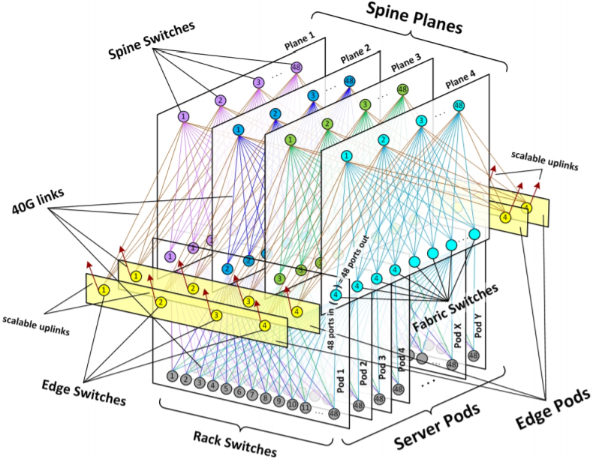
Facebook Datacenter
The datacenter we consider serves web requests from a multitude of end users, and is comprised primarily of web servers and cache servers
A few tens of racks comprises a pod.
Each pod also contains four aggregation switches (Aggs). Each ToR has four uplinks, one to each Agg.

Slide 8
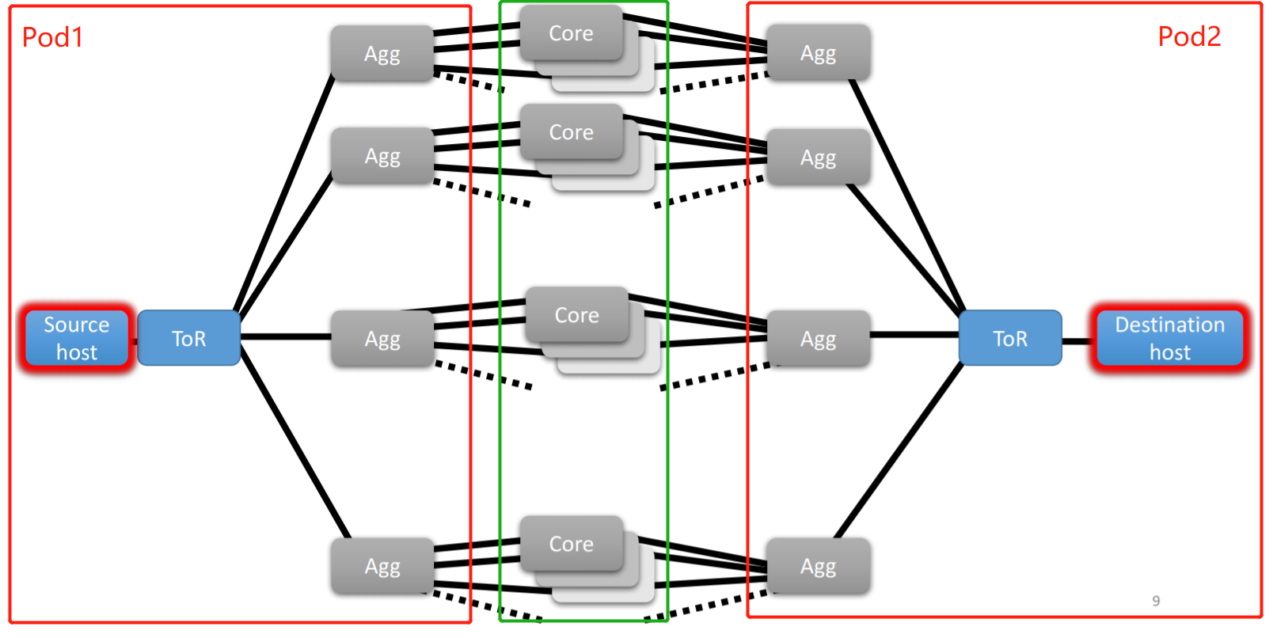
Facebook Datacenter
Notes:
Each pod also contains four aggregation switches (Aggs).
Each ToR has four uplinks, one to each Agg.
cross-pod communication enabled by four disjoint planes of core switches
links at the
same hierarchical level of the topology end up with a
very even distribution of a large number of flows.
if we know which path (i.e., set of links) every flo
traverses, it is straightforward to separate the flows into
bins based on the link they traverse at any particular level
of the hierarchy.
Hence, we can simultaneously perform
fault identification and localization by considering performance
metrics across different subsets of flows.

Slide 9
Motivation
Evenly loaded paths means per path performance is similar if no errors.
Network faults lead to outlier paths.
If flow network path known, can correlate flow performance with path.

Slide 10
Motivation
Full path information
Passive monitoring, not active probing
Decreasing network overhead, decreasing detection and localization time.
Reduced switch dependencies
Some approaches require expanded switch ASIC features for debugging networks, we do not require them.
No per-application modeling
Do not require explicit performance thresholds.
Rapid online analysis
We can rapidly (10-20 seconds) detect partial 0.5% faults of very small magnitude (packet loss) using an online approach.
Notes:
(2) 通过发包是比较消耗带宽的，而且发包用时也比较久，比如说为了覆盖掉所有的link，然后两两host之间发traceroute时间是很久的。甚至说有些方法为了计算得到丢包率是会发很多包的。之前有篇netbouncer…
(3) 有些方法可以检测到包的历史路径然后去定位故障，但是这是需要去改一下ASCI芯片才可以支持的，可部署性比较差
(5) 可以实时地进行分析，而且在较短的时间内可以识别出0.5%的故障。
因此，我们提出一个系统，不关注网络异常的发生，而是关注它们对流量的影响。

Slide 11
Challenges
The large number of links and switches require our system to be robust to the presence of multiple simultaneous errors, both unrelated (separate components) and correlated (faults impacting multiple links).
An improper choice of metric can risk either masking faults or triggering false positives(ex. request latency)
We must be able to support measurements from large numbers of end hosts describing the health of a large number of links, without imposing large computational or data overheads either on the end hosts or on the network.
Notes:
The large error will mask small error.
require application-agnostic metrics request latency is influenced by network faults but also cache misses, request size and server loads).
Low overhead

Slide 12
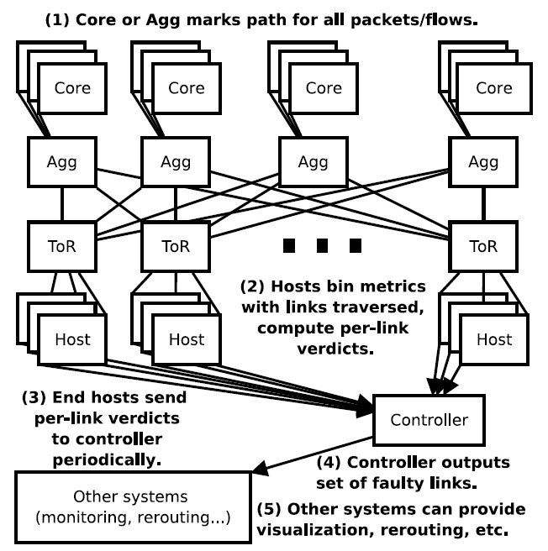
System architecture
Path Marking
End-host Aggregating metrics by Equivalence set
Host Verdict generation
Controller filter and output the result

Slide 13
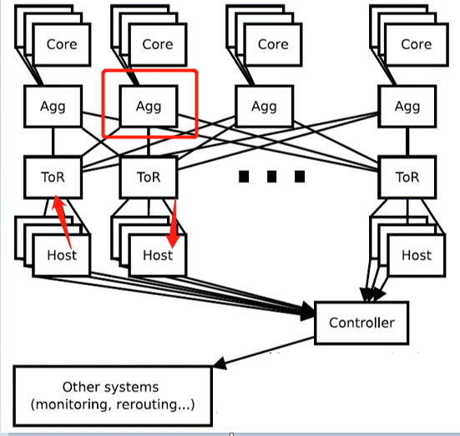
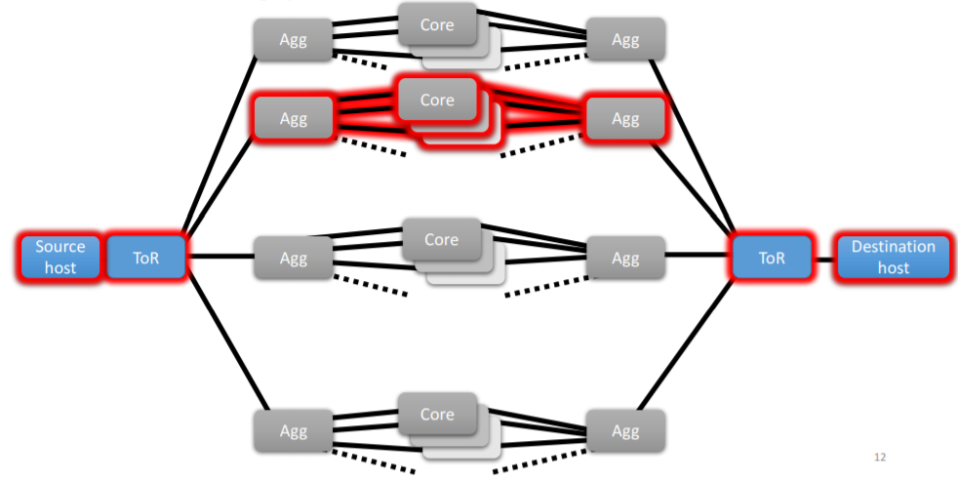
Packet Marking
Intra-Pod
Cross-Pod

Slide 14
Packet Marking Implementation
Mark Method: Assign id to core and agg
Mark bit: IPv6 flow label field(20-bit) /DSCP field/TTL field(3–255).
Mark device: Core Switch and Aggregate Switch and the device connected with them
Notes:
One possibility is the IPv6 flow label field; a 20-bit ID could scale to a network with over a million core switches. DSCP field A packet marked at a downward-facing Agg traverses exactly two more hops before arriving at the destination host; a host could recover an ID in the TTL field as long as the value was in the range 3–255.

Slide 15
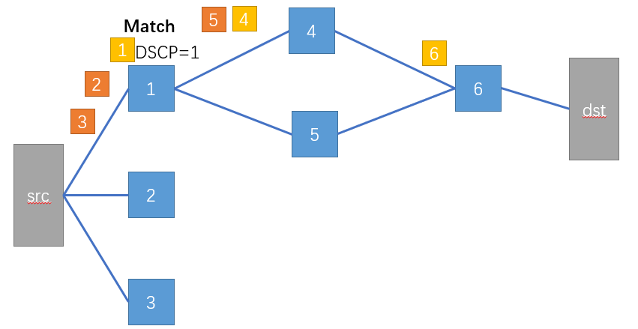
General Case
Suppose there are H hops between source and destination system, and C routing choices per hop
If the flow sends (>=H*C) packets in total it can discover the entire path at the expense of just a single rule per switch
Notes:
到达每一跳之后, 根据下一跳的switch id 设置ipv6 label，如果label==id, switch会把DSCP bit设置为1. 最终根据DSCP bit为1的包的ipv6 label可以还原出路径

Slide 16
System architecture
Path Marking
End-host Aggregating metrics by Equivalence set
Host Verdict generation
Controller filter and output the result
Notes:
注意(5) 可以提供重新路由，因为一些subset会丢失，只需要对subset进行重新路由，而不是对整个通过该link的flow进行重路由

Slide 17
Aggregating metrics
Use Linux eBPF (Extended Berkeley Packet Filter) along with bcc (BPF Compiler Collection) instrumentation at end hosts to read packet markings and derive flow paths.
Collect flow metric by link
Read netlink socket (similar to the ss(socket statistics) command.)
Each metric is bucketed four times: into the inbound and outbound rack and aggregation (up/down)links traversed. (Bidirectional)
TCP: cwnd, srtt, ssthresh, retransmission I/O: System call latency(select()/epoll())
Group link by Equivalence sets
Reduces number of comparisons needed.
Pinpoints fault to specific location.
Notes:
捕捉和过滤符合特定规则的网络包，可以用bcc提供的python库自己开发eBPF应用
we again leverage eBPF to track system-call latencies.
For TCP statistics, we directly read netlink sockets in a manner similar to the ss(socket statistics) command.
why by link not by path
• In principle: can compare flow performance by path.
Combinatorial disaster: O(10,000) paths from single host to remote racks.
No localization: doesn’t tell us which link/switch is at fault. • But: for this traffic pattern, ECMP routing gives us even bytes/link.
• Solution: Just compare links!
the highvolume flows in Hadoop allow us to adopt a higher-level, protocol-independent metric that depends on the buffer dynamics present in any reliable transport protocol.

Slide 18
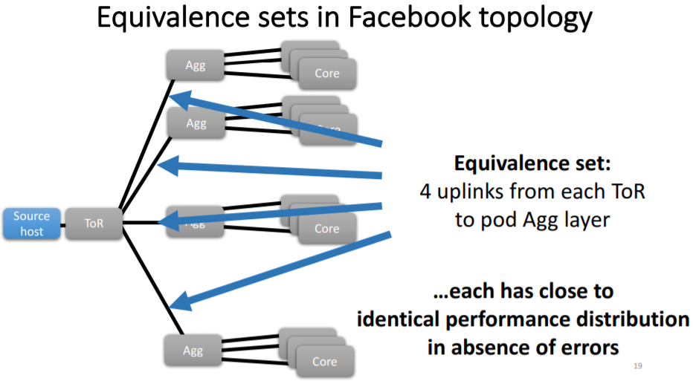
Equivalence sets
Notes:
对于每个pod构造Equivalence
cwnd和ssthresh慢启动阈值会因为丢包变小，但是具体的大小是和应用相关的，一些大流的拥塞窗口本来就比小流的大，如果统计流的信息和平均水平比显然是不合适的。
Retransmission的话虽然可以知道丢包，但是不通过在等价集合之间比较无法准确定位
srtt 是用来检测导致长时延的故障
select() or epoll (),当丢包的时候，会导致缓冲区的数据交付给上层时间较慢，需要reordering，select和epoll没有收到数据就会阻塞

Slide 19
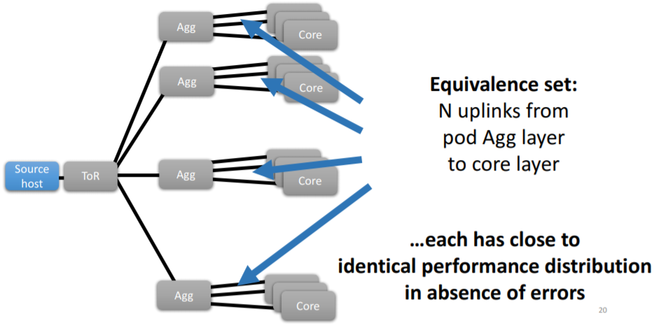
Equivalence sets
Notes:
万一出现了fail-stop故障，这些ES性能还会一致吗
Hosts already track metrics for congestion control or performance monitoring:
TCP Congestion window: Affected by packet loss.
TCP Retransmits: Affected by packet loss.
Smoothed Round trip time: Affected by latency spikes.
System call latency: Affected by packet loss.
Caveat: Can be difficult to determine if an affect is due to a faulty link, overloaded hosts, application variance, etc.

Slide 20
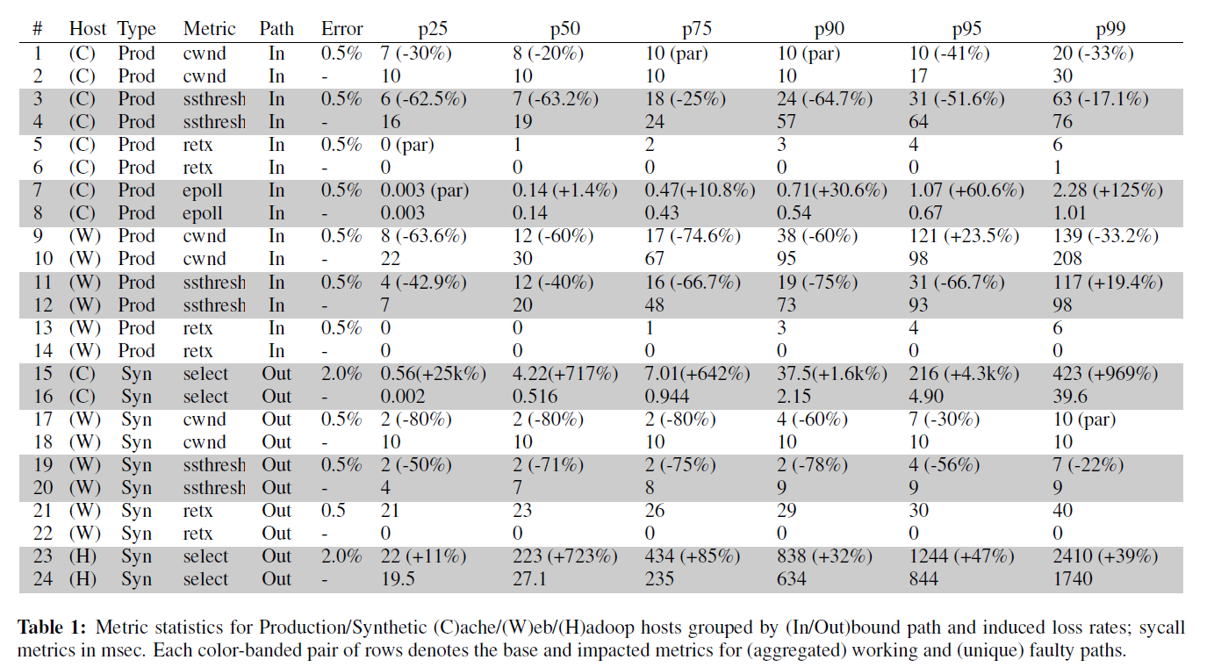
Notes:
Prod： 真实的数据中心环境
Syn：拓扑打流符合数据中心的流量分布

Slide 21
System architecture
Path Marking
End-host Aggregating metrics by Equivalence set
Host Verdict generation
Controller filter and output the result

Slide 22
Classifying faulty links
The distribution under consideration is faulty and the aggregate contains samples from exclusively non-faulty links
The distribution under test is skewed significantly to the right of the aggregate
It is non faulty and the aggregate contains samples from 1 faulty link and (N-1) working links
It is skewed slightly to the left (due to the influence of the single faulty link in the aggregate).
Notes:
However, our method is robust even in the case where 75% of the links have faults; we examine the sensitivity of our approach in Section 5.4.2.
if every link in an ES is performing similarly, then either none of the links are faulty, all of them are faulty (unlikely in a production network) or a fault exists but might be masked by some other bottleneck (for which we cannot account).

Slide 23
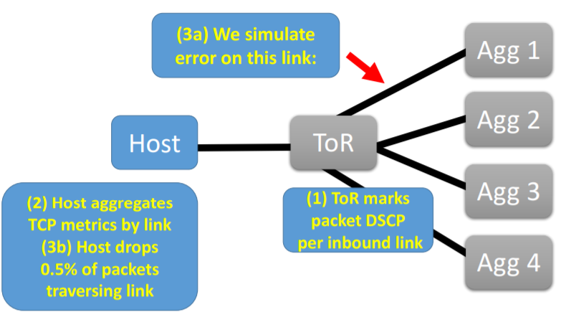
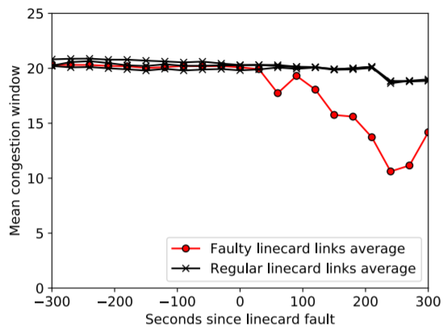
Classifying faulty links
“Does this link have more retransmits per flow than the other links?”
“Do two distributions have the same mean, or is one greater?”

Slide 24
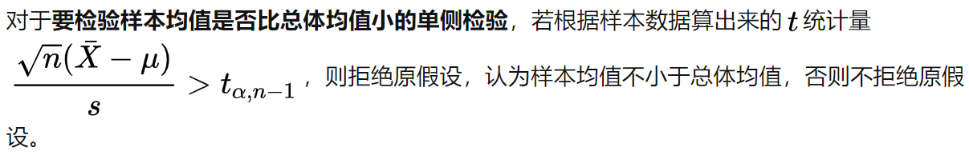
One-sample t-test
用于检验 总体方差未知、正态数据或近似正态的单样本的均值 与已知的总体均值之间的关系
H0 : µ ≤ µ0 ⇐⇒ H1 : µ > µ0 (right-sided).
Notes:
这是是双侧检验所以是alpha/2, 如果是单侧检验的话就是alpha

Slide 25
One-sample t-test
Classifier: compare each link to other links with one sample Student’s T-Test
The t-test compares a sample mean to a population mean, rejecting the null hypothesis if the sample mean is larger in our case, if the tested link has more retransmits or higher system-call latency than the other links in aggregate.
The host return (t-stat and p-value) and a link ID
For cwnd, ssthresh and srtt TCP statistics, we find the student’s t-test to be too sensitive in our environment. (Use KS-2 test)
T-test: retransmission and system call latency

Slide 26
System architecture
Path Marking
End-host Aggregating metrics by Equivalence set
Host Verdict generation
Controller filter and output the result

Slide 27

Filter out individual false positives
Why need to filter out individual false positives？
Type I Error = P(normal | faulty)
Type II Error = P(faulty | normal)
Notes:
假设检验最终结果是尽可能让第一类错误少犯，但是犯第二类错误的可能性就比较大, 所以需要filter out

Slide 28
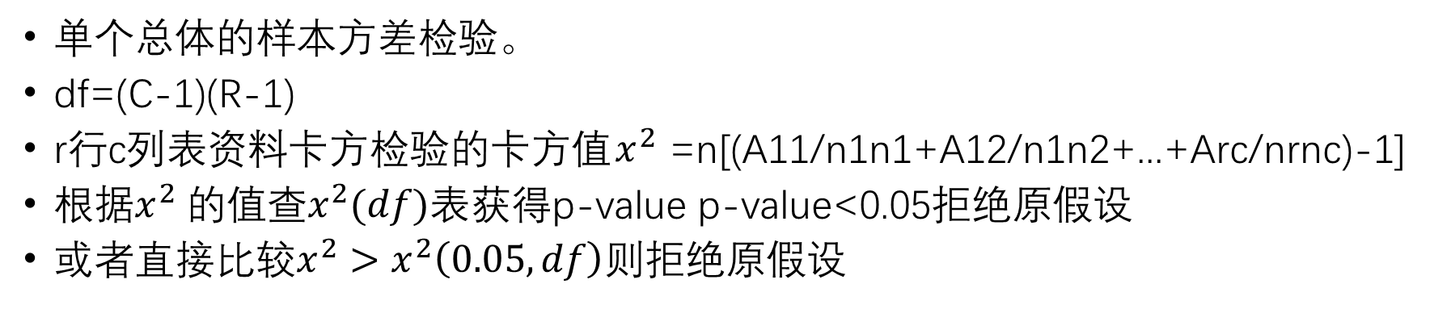
chi-square test
单个总体的样本方差检验。
df=(C-1)(R-1)
r行c列表资料卡方检验的卡方值$x^{2}$=n[(A11/n1n1+A12/n1n2+...+Arc/nrnc)-1]
${{根据x}^{2} 的值查x}^{2}(df)表$获得p-value p-value<0.05拒绝原假设
或者直接比较${x^{2}>x}^{2}\left(0.05,df\right)则$拒绝原假设
Link ID | normal | fault | 合计
1 | 4 | 3 | 7
2 | 5 | 6 | 11
3 | 3 | 5 | 8
4 | 5 | 4 | 9
合计 | 17 | 18

Slide 29
Filter out individual false positives
amongst links in the absence of faults
We use a chi-squared test with the null hypothesis that, in the absence of faults, all links will have relatively similar numbers of hosts that flag it not-guilty.
Hypothesize that false positives should be evenly distributed
Notes:
控制器会从host收集到link的判断结果,得到每个link被判断为正常的次数和故障的次数。
卡方检验:原假设,在没有故障的情况下所有link被标记为正常的次数是相近的。
如果p-value<0.05 就把最少标记为正常的link标记为故障, 然后继续迭代进行, 直到没有标记更新。

Slide 30
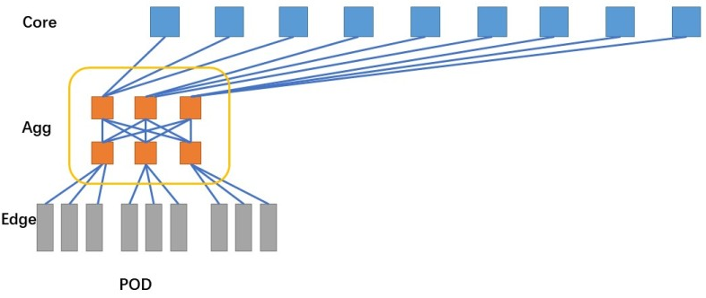
Evaluation
Environment:
Facebook datacenter: 86个web server
Inject Faults: iptables
Private testbed
Inject Faults: network bridge and tc-netem
Notes:
Iptables: 过滤固定标记的DSCP位去产生随即丢包
tc-netem可以为网卡添加 netem 配置，然后去增加传输时延/随即丢包
3个pod，27个hosts

Slide 31
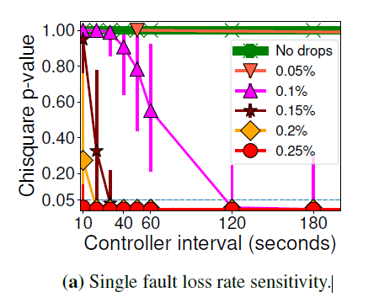
Speed and sensitivity
Notes:
10s的interval可以检测出high latency
实验方法：
To do this, we used Linux tc-netem on our ‘bump-in-the-wire’ network bridges to add constant delay varying from 100 microseconds to 1 millisecond (a typical 4-MB switch buffer at 10 Gbps can incur a maximum packet latency of roughly 3 milliseconds before overflowing). We then ran client/server traffic with a single pod of 9 HHVM [5] servers serving static pages, and two pods (18 hosts) configured as web clients running Apache Benchmark [1]. Each server handled 180 simultaneous clients and served either small (100-B) or medium (8-KB) requests.
1个pod里面 9个服务器 2个pod里面放18个客户端
构造c/s流量,然后在client端记录。每个服务器同时处理180个并发的客户端请求,请求大小为100B或者8KB
KS-2检验在10s内识别出故障，且没有假阳性。

Slide 32
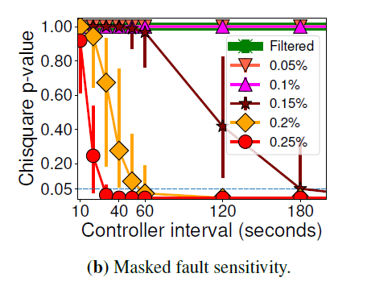
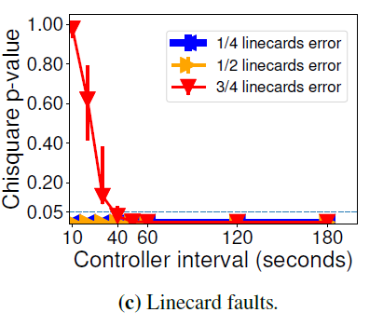
Precision and accuracy
Concurrent unequal faults：One causing a packet loss rate of 0.5%, and one with a rate that varies from 0.25% to 0.15% (which we can easily identify in isolation).
Large correlated faults：induce linecard-level faults on 25%, 50%, 75% and 100% of the uplinks on the instrumented Agg switch in the Facebook datacenter. The per-link loss rate in each case was 0.25%.
Notes:
当观测链路为丢包率低的故障时,和其他剩余链路比较(包含丢包率高的链路和正常链路),丢包率高的链路对整体的均值影响较大,可能导致总体均值和观测链路差距较小。

Slide 33
False positives
The longer our controller interval, the more sensitive we are to catching low-impact faults but the more likely we are to be subject to false positives
Intervals ranging from 10 seconds to an hour. Only one-hour intervals generated any false positives in our data.

Slide 34
Granular faults and alternative binnings
The longer our controller interval, the more sensitive we are to catching low-impact faults but the more likely we are to be subject to false positives
Intervals ranging from 10 seconds to an hour. Only one-hour intervals generated any false positives in our data.
Notes:
计算metric是基于link, 现在是基于rack，说明其可扩展性

Slide 35
Overhead
The host has low CPU overhead
The controller has low CPU overhead: a Python implementation computes 10,000 rounds for tens of links in <1 second on a Xeon E5-2660, and scales linearly in the number of links.
Each host generates two verdicts per link (inbound/outbound) every 10 seconds, with O(1000s) hosts per pod. In total, this yields a streaming overhead of < 10 Mbps per pod, well within the capabilities of the pub-sub framework.

Slide 36
Metric Robustness
High CPU utilization
Uneven load
Notes:
each host in our private testbed runs two virtual machines, cpuvm and netvm.

Slide 37
Metric Robustness
The effect of buffer size
The effect of NIC offloads
Notes:
增大max-buffer影响不大，减小max-buffer影响大
关闭TCP Segmentation Offload，网卡不对数据包进行整合和切分。这部分压力会给到CPU
(buffer和uneven load的影响比较大)

Slide 38
Limitations
Datacenter networks with mixed workloads may include links that see more traffic and congestion than others.
Can’t detect links lacking alternatives(such as an end host to top-of-rack access link in the absence of multihoming)
Other scene: RDMA-based applications or datacenter fabrics.
[IEEE/ACM TRANSACTIONS ON NETWORKING 2019]Understanding the Limits of Passive Realtime Datacenter Fault Detection and Localization
Notes:
流量均匀分布不成立
对于有些link不能进行对比分析
对于基于RDMA的应用, 收集tcp的数据就没啥用, 因为RDMA不走协议栈

Slide 39
Future Work
In the case of a network with complicated topologies, we can still make headway by considering links at every multipath decision point as a single equivalency group.
如果这些链路中的一个表现出异常性能，则可以将穿过该链路的流单独标记为故障，而不是将该链路作为一个整体进行标记，并且可以将该流和所遍历的路径作为基于图的故障定位算法（如SCORE[25]或Gestalt [30]）的输入。
Notes:
复杂拓扑中，可以对部分采用文章提出的方法
ECMP
1、直通交换方式（Cut-through）
采用直通交换方式的以太网交换机可以理解为在各端口间是纵横交叉的线路矩阵电话交换机。它在输入端口检测到一个数据包时，检查该包的包头，获取包的目的地址，启动内部的动态查找表转换成相应的输出端口，在输入与输出交叉处接通，把数据包直通到相应的端口，实现交换功能。由于它只检查数据包的包头（通常只检查14个字节），不需要存储，所以切入方式具有延迟小，交换速度快的优点。所谓延迟（Latency）是指数据包进入一个网络设备到离开该设备所花的时间。

